Slide 1


SMART INDIA HACKATHON 2024
Problem Statement ID – 1594 Problem Statement Title- Student Innovation Theme- Efficiency Enhancement PS Category- Software Team ID- Team Name (Registered on portal)

Slide 2


IDEA TITLE
Description: A platform connecting transport seekers with truck drivers, featuring real-time tracking, instant pricing, and load matching. Problem Addressed: Solves issues of reliability, cost uncertainty, and inefficient load matching for seekers and drivers. Innovation: Integrates advanced search, instant payments, and route optimization, offering a transparent and user-friendly interface for both parties. Proposed Solution (Describe your Idea/Solution/Prototype): Haul Harmony
Real-Time Tracking
Provides live location updates for trucks, enabling efficient route planning and timely delivery.
Instant Pricing
Offers transparent and competitive pricing based on distance, load type, and market demand.
Load Matching
Connects seekers with suitable drivers based on cargo type, destination, and availability.
User-Friendly Interface
Provides a seamless experience for both seekers and drivers, simplifying the logistics process.

Slide 3


TECHNICAL APPROACH
Technologies to be Used: Frontend: React.js Backend: Node.js/ Express Database: MongoDB Real-Time Tracking: Google Maps API Payment Gateway: Paytm Methodology & Process: Design Phase: Create wireframes and UI/UX designs. Development Phase: Build frontend, backend, and database integration. Testing Phase: Conduct functionality and usability testing. Deployment Phase: Deploy on cloud servers and ensure scalability.
1
Design Phase
Create wireframes and UI/UX designs to ensure a user-friendly and intuitive platform.
2
Development Phase
Build the frontend, backend, and database integration using React.js, Node.js/Express, and MongoDB.
3
Testing Phase
Conduct thorough functionality and usability testing to ensure a smooth and reliable user experience.
4
Deployment Phase
Deploy the platform on cloud servers, ensuring scalability and accessibility for a wide user base.

Slide 4
FEASIBILITY AND VIABILITY
Feasibility Analysis: Potential Challenges & Risks: Strategies for Overcoming Challenges:
Technical Integration
User Adoption
Data Security
Complexities in integrating real-time tracking and payment systems.
Difficulty in gaining traction among both truck drivers and logistics seekers.
Ensuring protection of sensitive user information and transaction data.
Technical Integration
User Adoption
Data Security
Use well-documented APIs and robust development frameworks to ensure seamless integration.
Implement targeted marketing and onboarding processes; offer initial incentives to attract users.
Employ encryption, secure authentication, and regular security audits to safeguard user data.

Slide 5


IMPACT AND BENEFITS
Potential Impact: Target Audience: Logistics companies and truck drivers. Benefits:
1
Social
Enhances transparency and reliability in logistics, improving trust between seekers and drivers.
2
Economic
Reduces costs through efficient load matching and instant payments; minimizes empty return trips.
3
Environmental
Optimizes routes, leading to reduced fuel consumption and lower carbon emissions.

Slide 6

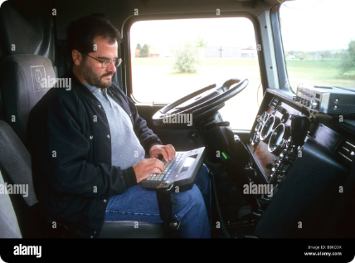
RESEARCH AND REFERENCES
Details / Links of the reference and research work
Reference 1
Link 1
Reference 2
Link 2
Reference 3
Link 3

Slide 7






IMPORTANT INSTRUCTIONS
Note - You can delete this slide (Important Pointers) when you upload the details of your idea on SIH portal. Kindly keep the maximum slides limit up to six (6). ( Including the title slide) Try to avoid paragraphs and post your idea in points /diagrams / Infographics /pictures Keep your explanation precise and easy to understand Idea should be unique and novel. You can only use provided template for making the PPT without changing the idea details pointers (mentioned in previous slides). You need to save the file in PDF and upload the same on portal. No PPT, Word Doc or any other format will be supported.
Slide Limit
Maximum of 6 slides, including the title slide.
Content Format
Use points, diagrams, infographics, or pictures instead of long paragraphs.
Clarity
Keep explanations concise and easy to understand.
Originality
Ensure your idea is unique and innovative.

